Slide 1
Demonstration of Mobile Device WiFi Operational (In)Security,
by @SpyBlog
11 September 2017

Slide 2
Anonymity loves Crowds – Spies are snooping on MobilePhones
#Snowden doc – NSA Co-Traveller
https://assets.documentcloud.org/documents/888734/cotraveler-tracking-redacted.pdf

Slide 3
Anonymity loves Crowds – Spies are snooping on Airport WiFi
#Snowden doc - Canada’s CSEC
http://www.cbc.ca/news2/pdf/airports_redacted.pdf

Slide 4
Anonymity loves Crowds
Domestic or Foreign intelligence agencies usually do not spy on you directly, they use & abuse the massive Commercial / Private Sector / Domestic WiFi infrastructure
Provided you do not exceed the radio transmission power levels, there is no regulation of WiFi
i.e. snoopers have equal rights to use the same WiFi signals & protocols that you do

Slide 5
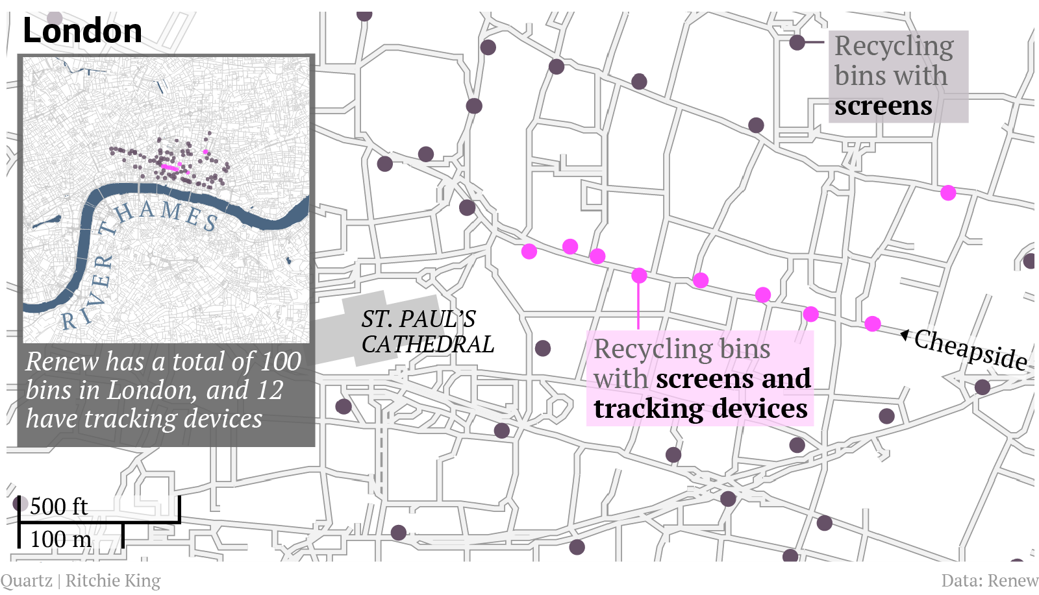
2013 City of London WiFi bins
https://qz.com/112873/this-recycling-bin-is-following-you/

Slide 6
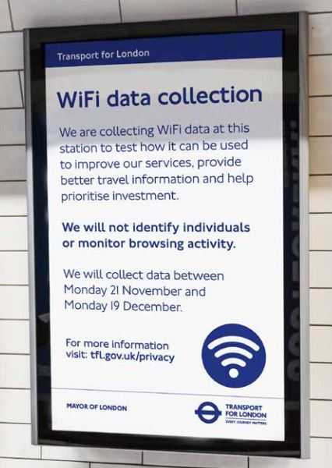
TfL Tube WiFi snooping pilot Nov – Dec 2016
http://content.tfl.gov.uk/review-tfl-wifi-pilot.pdf

Slide 7
TfL Tube WiFi snooping pilot Nov – Dec 2016
http://content.tfl.gov.uk/review-tfl-wifi-pilot.pdf

Slide 8
There are lots of WiFi Access Points
Previous slide TfL snooped via 1070 Aps
An idea of just how dense the UK WiFi space is:

Slide 9
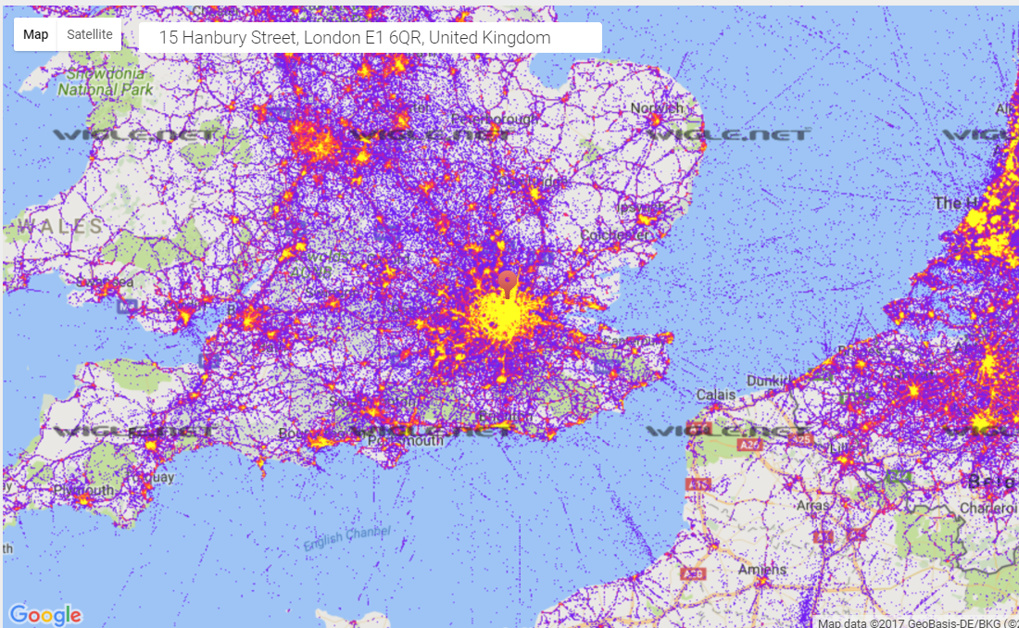
wigle.net – WiFi Access Point SSID
wigle.net -15 Hanbury Street

Slide 10
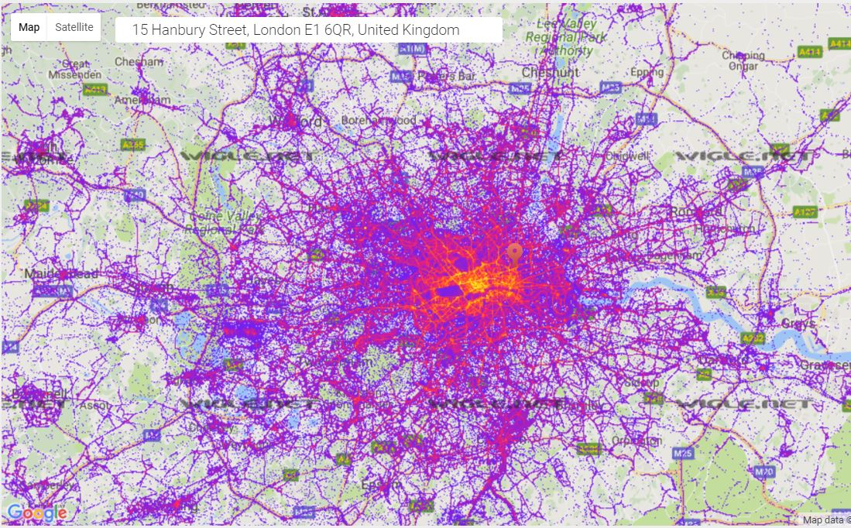
wigle.net – WiFi Access Point SSID
wigle.net -15 Hanbury Street
wigle.net -15 Hanbury Street
wigle.net -15 Hanbury Street
wigle.net -15 Hanbury Street

Slide 11
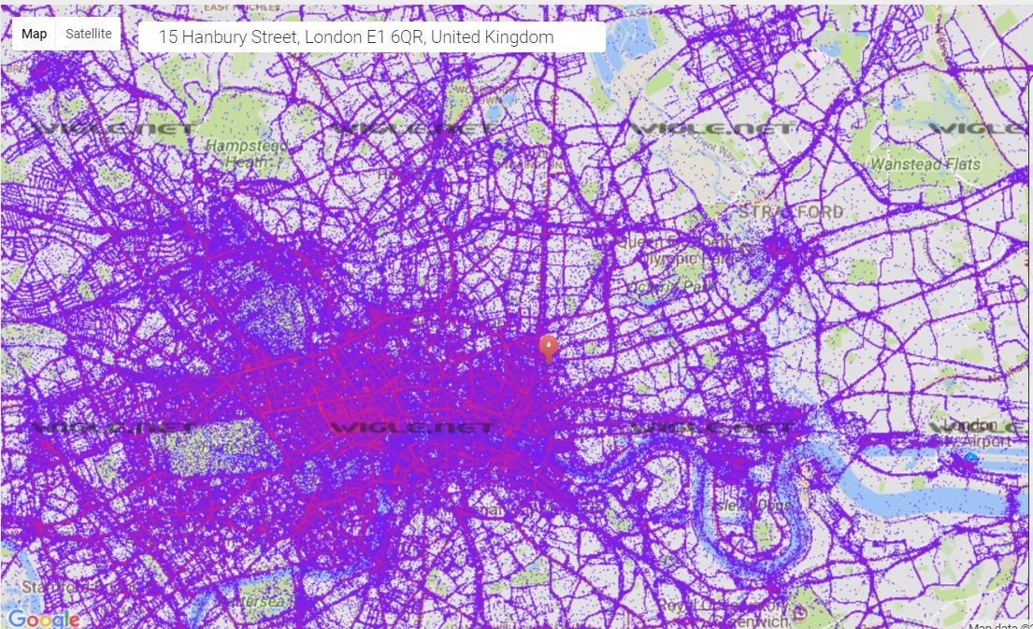
wigle.net – WiFi Access Point SSID
wigle.net -15 Hanbury Street
wigle.net -15 Hanbury Street
wigle.net -15 Hanbury Street
wigle.net -15 Hanbury Street

Slide 12
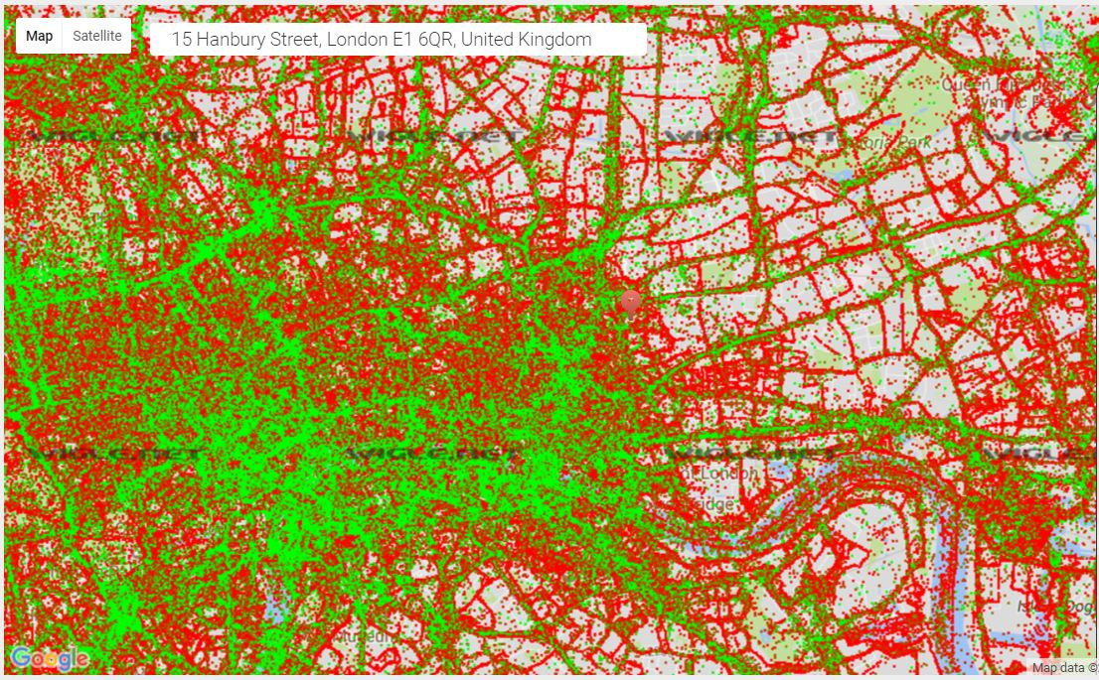
wigle.net – WiFi Access Point SSID
wigle.net -15 Hanbury Street
wigle.net -15 Hanbury Street
wigle.net -15 Hanbury Street
wigle.net -15 Hanbury Street

Slide 13
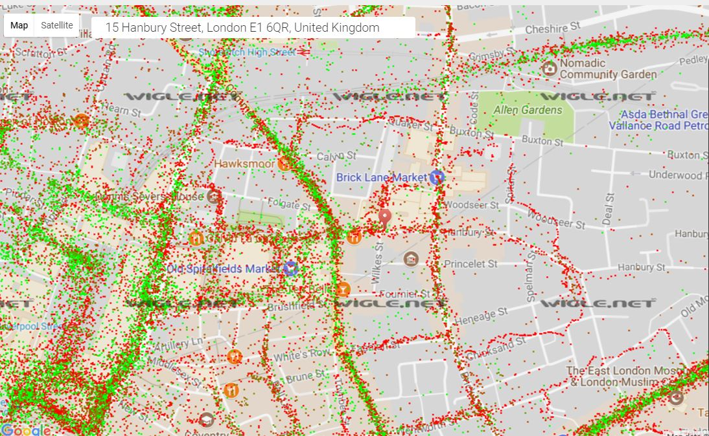
wigle.net – WiFi Access Point SSID
wigle.net -15 Hanbury Street
wigle.net -15 Hanbury Street
wigle.net -15 Hanbury Street
wigle.net -15 Hanbury Street

Slide 14
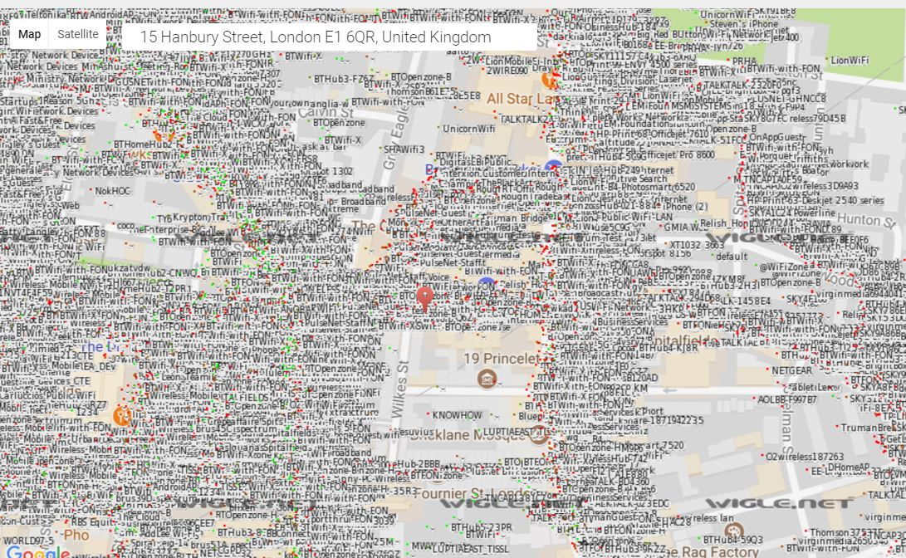
wigle.net – WiFi Access Point SSID
wigle.net -15 Hanbury Street
wigle.net -15 Hanbury Street
wigle.net -15 Hanbury Street
wigle.net -15 Hanbury Street

Slide 15
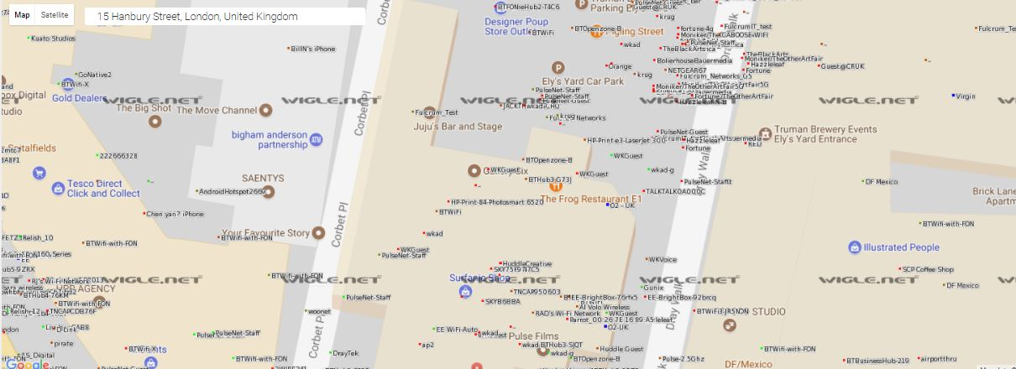
wigle.net – WiFi Access Point SSID
wigle.net -15 Hanbury Street
wigle.net -15 Hanbury Street
wigle.net -15 Hanbury Street
wigle.net -15 Hanbury Street

Slide 16
Anonymity loves Crowds – could be anywhere in UK
BTWiFi
BTWi-fi
BTWifi-with-FON
BTWifi-X
O2 Wifi
Wifi Extra
VodafoneWiFi
_The Cloud X

Slide 17
Anonymity loves Crowds – could be anywhere in UK
EE WiFi-Auto
Virgin Media WiFi
Virgin Media

Slide 18
Anonymity loves Crowds – could be on the move
AddLee Wi-Fi
National Express Coach
megabus-wifi
ABELLIO-BUS

Slide 19
Anonymity loves Crowds – could be tracked on the move
Audi_MMI_3944
Audi_MMI_4579
Porsche_WLAN_817e5f

Slide 20
Anonymity loves Crowds – I know where you have been
Gatwick FREE Wi-Fi
_Heathrow Wi-Fi
Nice Airport Free WiFi
_Bentall Centre FREE WIFI
The In and Out Club WiFi
_Gunwharf Quays Free WIFI
Free Kitzsteinhorn WiFi

Slide 21
Anonymity loves Crowds – several candidate locations
The Fox & Hounds
The Riverside
HP-Print-1C-Officejet Pro 8610
M&S Free WiFi
BarclaysFreeWiFi
McDonald's Free WiFi
Sainsbury's WiFi

Slide 22
Anonymity loves Crowds – Tracking your Home Address ?
BTHub4-CNT4
BT Smart Hub 2465
BTHub5-R7KS
TALKTALK8F32E4
TALKTALK-A63C9E
VM721616-2G
VM5223462

Slide 23
Anonymity loves Crowds only 3 data points to de-anonymise ?
virginmedia2721027,humbleabode,Applebees,HOTEL BROADBAND,Avonpark 2,SKY33BBE,DoubleTree Wireless,BTHub5-XWMZ,BTHub6-MGSM,SKY64926
Surrey Libraries,GOODTASTE,Comfort-Suites-Epernay,The Brickmakers Arms Free Wifi,Theatre_Public,BTWiFi,Livebox-A744,VM180992-2G,BTHub5-XKRP,PrimalRoost

Slide 24
Anonymity loves Crowds – trying to hide with unique ID
Police Surveillance Van #34
Police surveillance van 2
HELP I'M TRAPPED IN A ROUTER_EXT
Hanger_51_Guest
OOOOOH Look A Bird!
OneConnectionToRuleThem
Not The Wi-Fi You're Looking For

Slide 25
Grabbing WiFi MAC & SSID & Probes
Hardware incl cables
Raspberry Pi Zero or Zero W - £20
Raspberry Pi 2 B - £30 (no built in WiFi)
Raspberry Pi 3 - £40
N.B. the built in Broadcom WiFi does not support the necessary WiFi Monitor mode so:
WiFi dongle e.g. RALink RT5270 chipset £5 - £10
mobile device recharge USB battery pack £10 -£20

Slide 26
Grabbing WiFi MAC & SSID & Probes
Hardware
Maplin still stock a Raspberry Pi 2 B kit with Mouse, Keyboard, powered USB hub, Ethernet, HDMI cables, microUSB power supply, NOOBS microSD and a RTL5270 WiFi dongle for just under £50
https://www.maplin.co.uk/p/quad-core-raspberry-pi-v2-development-kit-n01ea
(needs a case or tupperware box etc)
Battery pack

Slide 27
Grabbing WiFi MAC & SSID & Probes
Operating Systems for Raspberry Pi
Started off using the Raspi compatible version of Kali Linux, popular with Penetration Testers / hackers
Now the latest Raspian Stretch repositories have adequate versions of the Application software mentioned earlier

Slide 28
Grabbing WiFi MAC & SSID & Probes
Application Software (open source)
sudo apt-get install
kismet
airodump-ng part of aircrack-ng suite
Python scripts using scapy and python-netaddr
macchanger – script WiFi MAC address changes
wireshark
mdk3 –WiFi attack tool - can be used to fake SSID
tmux - keeps your sessions running when disconnected from SSH

Slide 29
How to protect your privacy & security
Disable WiFi (& BlueTooth) on your mobile device before you leave home or work (also saves battery)
Do not enable Connect Automatically
Check you have not enabled advanced persistent WiFi settings
WiFi on whilst in sleep mode
Automatically connect to Open Networks
Use common SSID at home or work without router serial number i.e. change VM123456 to Virgin Media
Change your WiFi Router default admin password

Slide 30
How to protect your privacy & security
Some devices, sort of, periodically randomise MAC addresses e.g. Apple IoS, but not if they are probing for an Out of Range SSID access point connection
You can try to pollute e.g. TfL MAC address snooping with a macchanger script to create multiple legitimate looking but fake WiFi MAC address signals

Slide 31
How to protect your privacy & security
It is easy for attackers to change the SSID of their own “Evil Twin” WiFi access points to something plausible e.g. McDonalds Free WiFi to try a Man-In-The-Middle attack on you.
You can fake lots of SSID for propaganda slogans with an mdk3 script
Only use encrypted https:// web connections if you are logging in to email or banking or e-commerce sites
Use a commercial or private Virtual Private Network VPN if using public “Free” WiFi

